Slide 1
Module: Control Layer
Upon completion of this module, you should be able to:
Describe the control layer and its key functions
Describe control software and its types
Describe the software-defined approach for managing IT resources
Describe the key resource management techniques
Notes:
This module focuses on the control layer of the cloud computing reference model and its key functions. This module also focuses on types of control software and software-defined approach for managing IT resources. It further focuses on the key resource management techniques that enable organizations to effectively optimize and utilize IT resources to meet the required service levels.

Slide 2
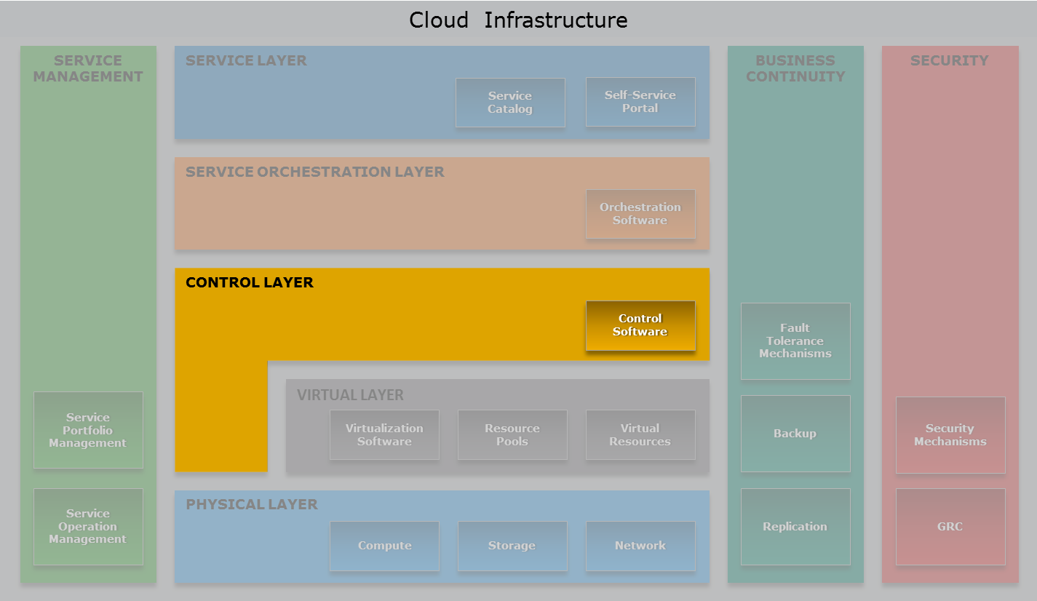
Cloud Computing Reference Model
Control Layer
Notes:
The control layer—highlighted in the figure on the slide—enables to manage and control the cloud infrastructure.

Slide 3
Lesson: Control Layer Overview
This lesson covers the following topics:
Control layer and its functions
Control software and its types
Key phases for provisioning resources using unified manager
Notes:
This lesson covers the control layer and its key functions. This lesson also covers the control software and its types. This lesson further covers the key phases for provisioning resources using unified manager.

Slide 4
Introduction to Control Layer
Control Layer
Includes software tools that are responsible for managing and controlling the underlying cloud infrastructure and enables provisioning of IT resources for creating cloud services.
Control layer can be deployed on top of the virtual layer or on top of the physical layer
Receives request from the service and orchestration layers
Provisions the required resources to fulfill the service request
Key functions of the control layer are resource configuration, resource provisioning, and monitoring resources
Notes:
The control layer includes control software that are responsible for managing and controlling the underlying cloud infrastructure resources and enable provisioning of IT resources for creating cloud services. Control layer can be deployed on top of the virtual layer or on top of the physical layer. This layer receives request from the service and orchestration layers, and interacts with the underlying virtual and physical resources for provisioning IT resources. For example, when a consumer initiates a service request (a VM instance with 4 GB RAM and 500 GB storage), based on the workflow defined by the orchestration layer for this service, the control layer provisions the required resources from the resource pool to fulfill the service request. This layer also exposes the resources (physical and/or virtual) to and supports the service layer where cloud services interfaces are exposed to the consumers. The key functions of the control layer includes resource configuration, resource provisioning, and monitoring resources.

Slide 5
Control Software
Ties together the underlying resources and works in conjunction with virtualization software to enable
Resource pooling
Dynamic allocation of resources for services
Optimizing utilization of resources
Provides a complete view of all the resources in the cloud environment
Enables to centralize management of IT resources
Two types of control software:
Element manager
Unified manager
Notes:
The control software ties together the underlying physical resources and their software abstraction to enable resource pooling and dynamic allocation of resources. It provisions resources for services and provides information about provisioned or consumed resources by service instances to the cloud portal and billing system. Before configuring the cloud resources, the control software should discover all the underlying resources in order to know the total available resources in the environment for service provisioning. This also provides a complete view of all the resources in the cloud environment and enables to centralize management of IT resources. The two types of control software are element manager and unified manager. The following slides will discuss the various key tasks performed by the element and the unified manager.

Slide 6
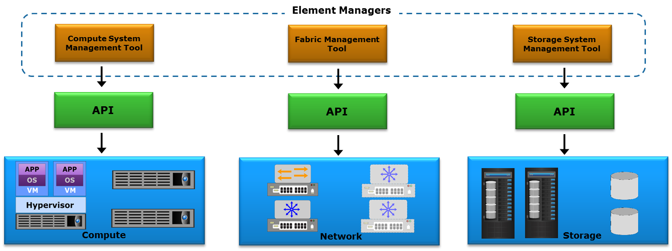
Element Manager
Infrastructure component vendors may provide the element managers as built-in or external software
Required to manage infrastructure components independently
Notes:
Infrastructure component vendors may provide the element managers as built-in or external software to configure those components or elements. For example, storage vendors offer element manager along with the storage system to configure and make the storage resources available for the applications or services. Similarly, network and compute systems are managed using network and compute management software, respectively. The figure on the slide depicts how various element managers are involved in managing the infrastructure components independently. Typically the underlying infrastructure is managed from element manager through either graphical user interface (GUI) or command line interface (CLI).

Slide 7
Key Tasks Performed by Element Manager
Enables to perform initial component configurations and allows to modify it
Installing guest OS, configuring zoning, security settings, VLANs, RAID, and LUN masking
Allows to expand resource capacity
Detects the newly added resources and adds them to an existing pool
Enables to identify the problem and performs troubleshooting
Monitors the infrastructure component for performance, availability, capacity, and security
Notes:
Element managers are required to support initial component configuration such as zoning, RAID levels, LUN masking, and firmware updates. They are also required when resource capacity need to be expanded for meeting the demands. For example, a storage element manager can be used by an administrator to detect the newly added drives and add them to an existing storage pool. Troubleshooting and monitoring capabilities may also be supported by element managers. Additionally, many security settings and policy configurations are managed through the element managers like Role-Based Access Controls (RBAC) type settings.
For a cloud infrastructure of significant size, especially where a variety of physical and virtual components exist, using these element managers alone to perform routine management tasks can become complex.

Slide 8
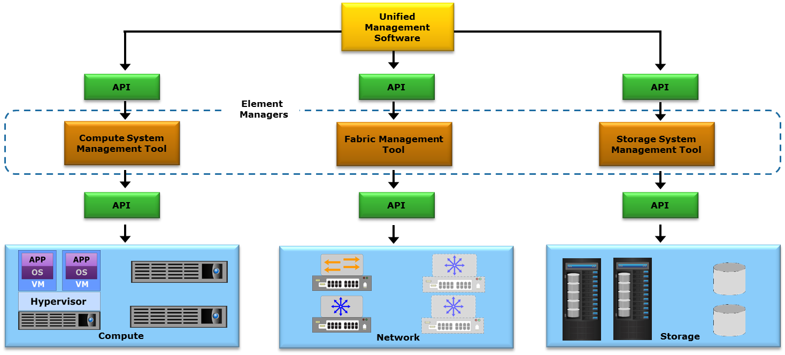
Unified Manager
Provides a single management interface for configuring and provisioning resources for applications and services
Notes:
Most vendors today include native APIs with their management software packages so that administrators can integrate them with other supporting tools. In a cloud environment where compute, storage, network, and other infrastructure elements work together, having a software solution that permits unified management and configuration provides simplification and improved efficiencies.
Unified manager provides a single management interface to manage cloud infrastructure resources and provisioning resources for services. Unified manager interacts with all standalone infrastructure elements through the elements’ native APIs. It discovers and collects information on configurations, connectivity, and utilization of cloud infrastructure elements. Unified manager compiles this information and provides a consolidated view of infrastructure resources wherever they reside. In addition, unified manager identifies the relationships between virtual and physical elements for easy management. It provides a topology or a map view of infrastructure, which enables an administrator to quickly locate and understand the interconnections of infrastructure components and services.

Slide 9
Unified Manager (Cont'd)
Exposes APIs that can be integrated with the orchestration layer to automate service provisioning
Enables adding or removing infrastructure resources to an already provisioned service
Performs compliance check during resource configuration
Provides a dashboard showing resource configurations and utilization
Allows administrator to perform monitoring, reporting, and root cause analysis
Notes:
Unified manager exposes APIs that enable to integrate with orchestration layer to automate resource provisioning for cloud services. After provision a service, there may be a need to add or remove resources (compute, storage, and network) to meet the changing business requirements. Unified manager allows to dynamically add or remove resources from a service without impacting the availability. It provides a dashboard that shows how the infrastructure is configured and how the resources are used. This enables an administrator to monitor the configuration and utilization of the infrastructure resources and to plan for capacity requirements. Unified manager also provides a topology or a map view of the infrastructure, which enables an administrator to quickly locate and understand the interconnections of the infrastructure components and services. It enables to enforce compliance by creating configuration policies which are applied to the resources consumed by a service instance. It helps to track the configuration changes and performs compliance checking to ensure that the resources are in a known configuration. It also prevents conflicting resource identity assignments, for example, accidentally assigning a MAC address to more than one virtual NIC. It provides an alerts console which allows an administrator to see alerts against the infrastructure resources and the associated services affected by the problems. The alert console facilitates identifying the services affected due to problems and the root causes of the problems. Knowing the root cause of a problem early enough helps to resolve problems faster.

Slide 10
Key Phases for Provisioning Resources
Resource Discovery
Resource Pool Management
Resource Provisioning
Key Phases in Provisioning Resources using Unified Manager
Notes:
The key phases for provisioning infrastructure resources to cloud services using unified manager are resource discovery, resource pool management, and resource provisioning.

Slide 11
Resource Discovery
Enables unified manager to learn about resources that are available for service deployment
Provides visibility to each resource
Enables to manage cloud infrastructure resources centrally
Compute Systems
Number of blade servers Slot location Blade model CPU speed, memory capacity, CPU, and memory pools Physical-to-virtual compute mapping
Network Components
Switch model Network adapters VLAN IDs VSAN IDs Physical-to-virtual network mapping QoS Zones
Storage Systems
Type of storage system, drive type Total capacity, free capacity, used capacity RAID level, storage pools Physical-to-virtual storage mapping
Notes:
Discovery operations create an inventory of the infrastructure resources, so that unified manager can learn what resources are available for cloud service deployment. Discovery also provides information about the assets including their configuration, connectivity, capacity, availability, utilization, and physical-to-virtual dependencies. Discovery provides cloud administrators with visibility into each resource and enables monitoring cloud infrastructure resources centrally. Typically, the unified manager interacts with element managers through APIs to discover resources in the environment. Discovery is usually scheduled by setting an interval for its periodic occurrence. Depending on the provider’s business requirements, a cloud administrator can change how often discovery runs. Discovery may also be initiated by a cloud administrator when a change occurs in the cloud infrastructure. During discovery, the unified manager captures information about the infrastructure resources such as:
Compute systems (number of blade servers, CPU speed, memory capacity, CPU and memory pools, mapping between virtual and physical compute systems)
Network components (switch model, network adapters, VLAN IDs, VSAN IDs, physical-to-virtual network mapping, QoS, network topology, zones)
Storage systems (type of storage system, drive type, total capacity, free capacity, used capacity, RAID level, storage pools, physical-to-virtual storage mapping)

Slide 12
Resource Provisioning
Resource Provisioning
Involves allocating resources from graded resource pools to the service instances.
Provisioning commences when consumers select cloud services from the service catalog
A service template defined in a service catalog facilitates consumers to understand service capabilities
Resources are allocated and configured as per service template to create an instance of a service
Notes:
Resource provisioning involves allocating resources from graded resource pools to the service instances. Resource provisioning starts when consumers select cloud services from the service catalog. A service template (will be discussed in detail in the ‘Service and Orchestration Layers’ module) defined in a service catalog facilitates consumers to understand service capabilities and provides guidelines to create workflows for service orchestration. The unified manager on receiving a provisioning request, allocates the resources and integrates as per the service template to create an instance of the service.

Slide 13
Lesson Summary
During this lesson the following topics were covered:
Control layer and its functions
Control software and its types
Key phases for provisioning resources using unified manager
Notes:
This lesson covered the control layer which includes the key functions of the layer. This lesson also covered control software and the key phases for provisioning resources using unified manager.

Slide 14
Lesson: Software-defined Approach
This lesson covers the following topics:
Introduction to software-defined approach
Key functions of software-defined controller
Benefits of software-defined approach
Notes:
This lesson covers the functionalities of software-defined approach, and the key functions of software-defined controller. This lesson also covers the key benefits of software-defined approach.

Slide 15
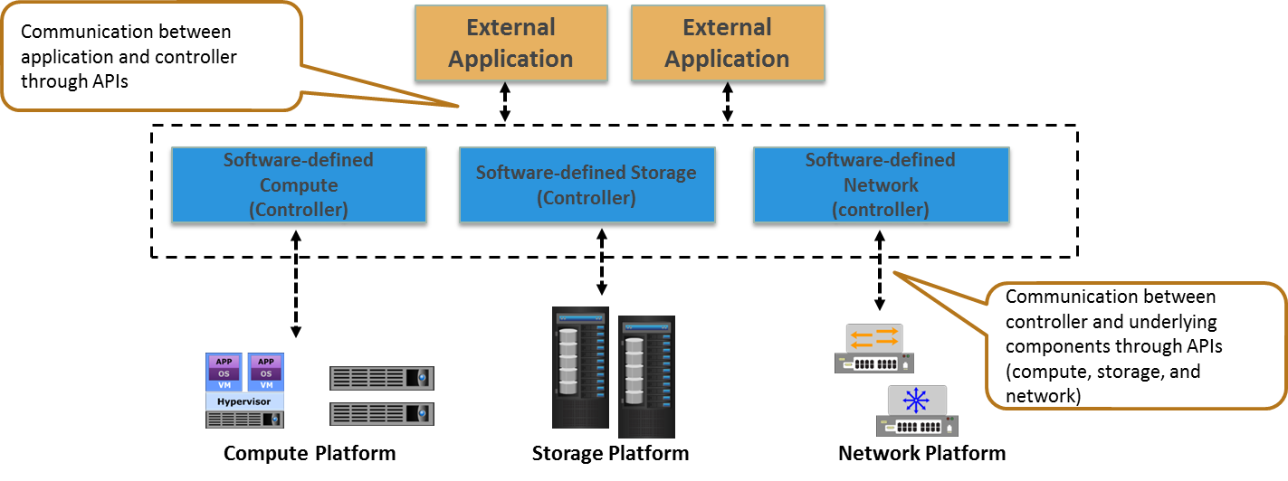
Software-defined Approach – A New Model For Managing Resources
Abstracts the underlying infrastructure components
Separates the management functions from the infrastructure components to the external software that runs on a controller
Enables controlling IT infrastructures centrally
Notes:
For any organization, it is becoming important to support its growth through virtualization, so that it can quickly and efficiently deliver cloud, big data and analytics, mobile, and social business services. Software-defined approach is the mechanism that helps in creating and implementing an optimized IT infrastructure that can help organizations achieve competitive advantage and higher value through speed and efficiency in delivering the services.
Software-defined approach abstracts all the infrastructure components (compute, storage, and network), and pools them into aggregated capacity. It separates the control or management functions from the underlying components to the external software, which takes over the control operations to manage the multi-vendor infrastructure components centrally. Principally, a physical infrastructure component (compute, network, and storage) has control path and data path. In simple terms, control path sets and manages the policies for the resources and the data path performs the actual transmission of data. Software-defined approach decouples the control path from the data path. By abstracting the control path, resource management operates at the control layer, which gives the ability to partition the resource pool and manage them uniquely by policy. This decoupling of the control path and data path enable to centralize all data provisioning and management tasks through software, external to the infrastructure components.
The software runs on a centralized compute system or a standalone device, called the software-defined controller. The figure on the slide shows an illustration of software-defined approach, where the management function is abstracted from the underlying infrastructure components using controller. From a data center aspect of software-defined approach, there is a software-defined compute, software-defined storage, and software-defined network.

Slide 16
Key Functions of Software-defined Controller
Discovers underlying resources and provides an aggregated view of resources
Abstracts the underlying hardware resources (compute, storage, and network) and pools them
Enables the rapid provisioning of resources based on pre-defined policies
Enables to apply policies uniformly across the infrastructure components, all from a software interface
Provides interfaces that enable applications external to the controller to request resources and access them as services
Notes:
A software-defined controller has built-in intelligence that automates provisioning and configuration based on the defined policies. It enables organizations to dynamically, uniformly, and easily modify and manage their infrastructure. The controller discovers the available underlying resources and provides an aggregated view of resources. It abstracts the underlying hardware resources (compute, storage, and network) and pools them. This enables the rapid provisioning of resources from the pool based on pre-defined policies that align to the service level agreements for different consumers. The controller enables a cloud administrator to manage the resources, node connectivity, traffic flow, control behavior of underlying components, apply policies uniformly across the infrastructure components, and enforce security, all from a software interface. The controller also provides interfaces that enable applications external to the controller to request resources and access these resources as services.

Slide 17
Benefits of Software-defined Approach
Improves business agility
Minimizes resource provisioning time to get new services up and running
Provides cost efficiency
Enables to effectively use the existing infrastructure and low-cost commodity hardware to lower CAPEX
Enables to achieve scale-out architecture
Provides a central point of access to all management functions
Allows to create new innovative services using the underlying resources
Notes:
Software-defined approach enables to provision resources for cloud services based on policies and applications as needed by the business in a very short time. It enables to deliver infrastructure resources to consumers via service catalog and provide on-demand self-service access to the consumers. This in turn will dramatically improve business agility. A software-defined approach increases the flexibility by abstracting the underlying IT resources to enable service providers to use low cost non-proprietary standard hardware and, in many cases, leverage the existing investment on infrastructure to dramatically lower capital expenditure (CAPEX). Abstracting the entire infrastructure through software-defined approach further enables to save CAPEX and operating expenditure by improving the utilization of resources. By abstracting physical resources into a virtual pool, service provider can achieve massive scale by aggregating an existing and new heterogeneous hardware components into limitless capacity available to the consumers. The software-defined approach provides a centralized management of heterogeneous resources to ensure service levels and monitor resource utilization. It allows to create new innovative services that span the underlying resources. For example, a new service called “object data service” can be created that provides the ability to store, access, and manipulate unstructured data (e.g. images, videos, audios, online documents) as objects on file-based storage system and exploiting the performance capabilities of that system.
Software-defined approach helps cloud service providers to provide the most efficient and scalable cloud solutions. Combining the transformational power of cloud computing with the benefits of software-defined approach enables cloud-based workloads to achieve their highest levels of performance, reliability, and scalability.

Slide 18
Lesson Summary
During this lesson the following topics were covered:
Functions of software-defined controller
Benefits of software-defined approach
Notes:
This lesson covered the functions of software-defined controller and the key benefits of software-defined approach.

Slide 19
Lesson: Resource Management Technique – 1
This lesson covers the following topics:
Resource management aspect of cloud infrastructure
Resource allocation model
Key compute resource management techniques
Notes:
This lesson covers the introduction to resource management aspect of cloud infrastructure and resource allocation model. This lesson also covers the various key compute resource management techniques: hyper-threading, memory page sharing, dynamic memory allocation, VM load balancing across hypervisors, and server flash-cache.

Slide 20
Introduction to Resource Management
Resource Management
Process of allocating resources effectively to a service instance from a pool of resources and monitoring the resources that help in maintaining service levels.
Key goals of resource management
Controls utilization of resources
Prevents service instances from monopolizing resources
Management server is used to centrally manage the resources
Enables defining policies
Configures and monitors the resources
Provides the ability to pool the resources
Notes:
Typically in a cloud environment, multiple consumers share the same underlying hardware resources. So it is important to effectively manage and monitor these resources to meet the required service level. Resource management includes allocation of resources effectively to a service instance from a pool of resources. The key goals of resource management are controlling utilization of resources and preventing service instances from monopolizing the resources. Monopolizing the resources can be avoided by controlling the allocation of resources to the service instance. The resources are managed from a centralized management server, which enables to define policies and configure resources. This management server also provides the ability to pool the resources, allocate, and optimize their utilization.

Slide 21
Resource Allocation Models
Relative resource allocation
Resource allocation to a service instance is defined proportionally relative to the resource allocated to other service instances
Absolute resource allocation
Resource allocation for a service instance is based on defining a quantitative bound
Lower bound guarantees minimum amount of resources
Upper bound limits a service instance from consuming resources beyond the defined maximum level
Notes:
Resources that are allocated to a service instance can be controlled based on one of the two models: relative resource allocation and absolute resource allocation.
In a relative resource allocation model, resource allocation for a service instance is not defined quantitatively. Instead, resource allocation to a service instance is defined proportionally relative to the resource allocated to other service instances. For example, consider two service instances with two different service levels: service instance 1 has “Platinum” service level with 2X priority and service instance 2 has “Gold” service level with X priority. When a resource contention occurs, the service instance 1 is allocated twice as much resource as service instance 2.
An absolute resource allocation model is based on defining a quantitative bound for the resources for each service instance. In this model, a lower and upper bound is defined. A lower bound guarantees the minimum amount of resources to a service instance. The upper bound limits a service instance from consuming resources beyond the defined maximum level. For example, consider a service instance (VM) that is configured with 2 GB memory capacity and 1200 MHz processing power as its lower bounds. The same VM is configured with 4 GB memory capacity and 2400 MHz processing power as its upper bounds. In this case, if the available memory capacity or processing power is less than 2 GB and 1200 MHz respectively, then the VM will not power on. On the other hand, even if the capacity greater than its specified upper bounds is available, the maximum amount of memory capacity and processing power this VM can consume is 4 GB and 2400 MHz, respectively.

Slide 22
Key Resource Management Techniques
Compute
Hyper-threading
Storage
Virtual storage provisioning
Storage pool rebalancing
Network
Balancing client workload across nodes
Network storm control
Memory page sharing
Dynamic memory allocation
VM load balancing across hypervisors
Storage space reclamation
Automated storage tiering
Cache tiering
Quality of Service (QoS)
Traffic shaping
Multipathing
Server flash-cache
Link aggregation
Dynamic VM load balancing across storage volumes
NIC teaming
Notes:
The slide listed some of the key resource (compute, storage, and network) management techniques that enable to optimize resource utilization, improve performance, and ensure meeting the service levels. Most of these techniques allow cloud administrators to set policies for managing resources effectively based on the requirements. Some of the techniques provide the capability to overcommit (more capacity is allocated than is actually available) CPU, memory, and storage resources to avoid frequent provisioning of resources, or to reduce disruption to application availability when adding new resources. This over-commitment enables to create more service instances but requires proper monitoring in place to avoid any downtime. The following slides will discuss these techniques in detail.

Slide 23
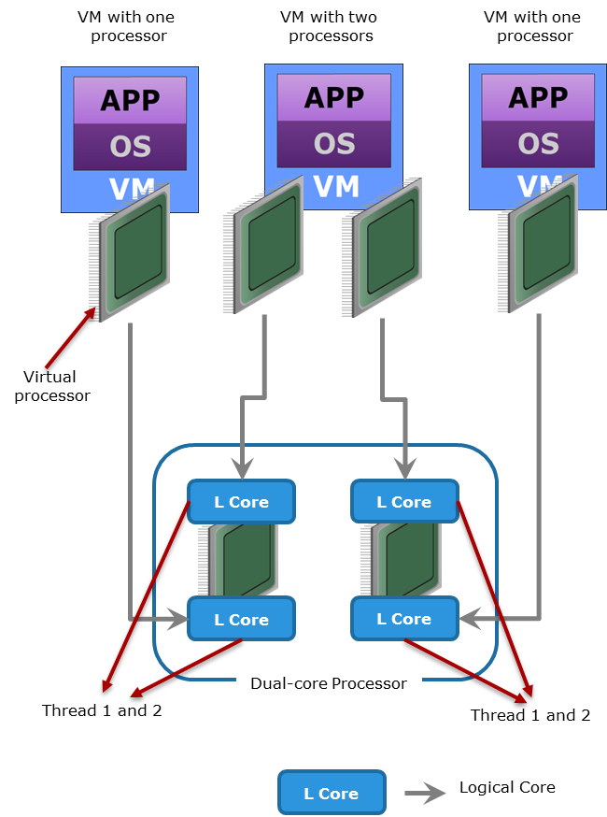
Hyper-threading
Makes a processor appear as two logical processor cores
Enables an OS to schedule two threads simultaneously
Two logical processor cores share the same physical resources
While the current thread is stalled, processor can execute another thread
Provides improved performance and utilization
Notes:
Hyper-threading makes a single processor core appear as two logical processor cores, allowing the hyper-threading enabled operating system (or hypervisor) to schedule two threads simultaneously to avoid idle time on processor. However, the two threads cannot be executed at the same time because the two logical cores share the resources of a single physical core. When core resources are not in use by the current thread, especially when the processor is stalled (for example due to data dependency), resources of the core are used to execute the next scheduled thread. When a service provider builds compute infrastructure using hyper-threading enabled processors and operating systems, the overall performance of the services running on these infrastructure can be improved.

Slide 24
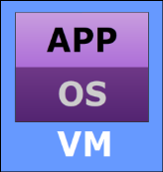
Memory Page Sharing
VM 1
VM 2
VM 3
Eliminates redundant copies of memory pages
Allows a greater degree of memory over-commitment
Hypervisor identifies redundant pages
VM memory pointer is updated to point to shared location
Redundant memory pages are reclaimed
1
2
3
…
n
1
2
3
…
n
1
2
3
…
n
VM 1 Memory
VM 2 Memory
VM 3 Memory
1
2
3
4
5
6
7
8
9
…
Shared Memory Page
Private Copy
Memory Page
Notes:
In a cloud environment, it is common that multiple VMs are running on a compute system, and this may increase the probability of having identical content in multiple memory pages. For example, VMs may run the same guest OS and have the same applications. This may create redundant copies of memory pages, and result in an increased consumption of memory resources. Memory page sharing is a technique by which the hypervisor scans the memory pages to identify the redundant pages, regardless of which VM created it. After the candidate memory page is identified, the VM memory pointer is updated to point to the shared location, and the redundant memory pages are reclaimed. Removing these redundant memory pages will enable to utilize the memory resources effectively and at the same time more memory can be assigned to the required VM instances to meet the demand.
The figure on the slide illustrates the process of reclaiming memory pages using the memory page sharing technique. Consider a physical compute system running three VMs namely VM 1, VM 2, and VM 3. In this scenario, the hypervisor scans the physical memory location and identifies that the contents of memory page 1 of VM 1, VM2, and VM3 are identical. In this situation, the hypervisor updates the memory map for the virtual memory page 1 for the three VMs to point to memory page 1 of the physical memory. In the absence of this technique, three physical memory pages would be consumed to store these three redundant memory pages. Similarly, virtual memory page 2 of VM 2 and VM 3 have identical pages and point to physical memory page 5. When VM 3 updates its virtual memory page 2, which points to the shared physical memory page 5, Copy-on-Write (CoW) is invoked to handle the updates. In CoW mechanism, when a shared page is updated, the hypervisor will transparently create a private copy of the physical memory page 5 to page 6 for that VM. The pointer map is updated to point to this private copy of the virtual memory page. In this way, the shared virtual memory pages can be modified non-disruptively.

Slide 25
Dynamic Memory Allocation
A memory optimization technique that reclaims memory pages
VMs have agent installed in guest OS that communicates with hypervisor
When memory become scarce:
Agent in a VM demands memory from their guest OS
Guest OS allocates memory pages to the agent
Agent reserves the memory and puts it back into memory pool
Hypervisor then assigns the relinquished memory pages to other VMs that require memory
Notes:
Dynamic memory allocation is a technique to reclaim memory pages. When a VM must free up memory, it is best to let the guest OS of the VM to select the memory pages to give up. The guest OS of the VM knows which pages have been least recently used and can be freed up. In this technique, each VM has an agent installed in the guest OS that communicates with the hypervisor. The agent’s function is to demand the memory from the guest OS and to relinquish it to the control of the hypervisor. When a compute system is not under memory pressure, no action is taken by the agent running within each VM. However, when memory becomes scarce, the hypervisor chooses VMs and instructs the agents in the VMs to demand memory from their guest OS. After the memory is reclaimed by the agent, the agent reserves the memory and puts it back into the memory pool. The hypervisor then assigns the relinquished memory pages from the pool to other VMs that require more memory. Consider a scenario in which an application running on a VM instance faces a sudden increase in the load. The VM would require additional processing power and memory to handle this increase in the workload, without impacting the service level. The dynamic memory allocation technique enables more memory resources to be assigned to the VM by reclaiming memory from other VMs in the environment.

Slide 26
VM Load Balancing Across Hypervisors
Provides uniform distribution of load across hypervisors
Key process involved in balancing load of VMs:
Management server checks the availability of resources on all hypervisors when a new VM is powered-on
Management server places the VM on a hypervisor with sufficient resources and ensures that the load is balanced
Management server monitors the load across hypervisors
If there is any imbalance, then the server balances the load by migrating the VMs from over-utilized to underutilized hypervisors
Notes:
To provide redundancy and load balancing, many hypervisors are clustered. In such environment, when a new VM is powered-on, the management server checks the availability of resources on all the hypervisors. It places the VM on a hypervisor where resources are sufficiently available and ensures that the load is balanced across hypervisors. Although the management server performs initial placements so that load is balanced across the clustered hypervisors, changes in the VM load and resource availability may cause the cluster to become imbalanced. To overcome such imbalance in load, the management server monitors all the hypervisors for resources and makes a balancing decision. The management server executes the load balancing decision by migrating VM from over-utilized hypervisors to underutilized hypervisors to avoid performance bottleneck. The management server makes its load balancing decision based on the configured threshold values. Threshold value is a measure of how much imbalance on a hypervisor’s resources (processor cycles and memory) is acceptable.

Slide 27
Server Flash-cache Technology
Uses intelligent caching software and a flash card on the compute system
Cache software places the most frequently referenced data on the flash card
Dramatically improves the application performance
Provides performance acceleration for read-intensive workloads
Avoids network latencies associated with I/O access to the storage system
Requires “warm-up” time before significant performance improvement is realized
Notes:
In server flash-caching, a flash memory cache card is installed in the compute system to enhance the application performance. Server flash-caching technology uses intelligent caching software and a flash card on the compute system. The cache software places the most frequently referenced data on the flash card, thereby putting the data closer to the application. This dramatically improves the application performance and avoids the latencies associated with I/O access over the network to the storage system. Server flash-caching technology provides performance acceleration for read-intensive workloads. As a result of server flash-caching implementation, a copy of the hottest data automatically resides on the flash card in the compute system for improving the performance. Server flash-caching needs “warm-up” time before significant performance improvement is realized. Warm-up time is the time required to move significant amount of data into server flash-cache. Typically this happens when the server flash-cache has been installed and is empty.

Slide 28
Lesson Summary
During this lesson the following topics were covered:
Resource allocation models
Hyper-threading
Memory page sharing
Dynamic memory allocation
VM load balancing across hypervisors
Server flash-cache
Notes:
This lesson covered the resource management aspect of cloud infrastructure and resource allocation model. This lesson also covered the various key compute resource management techniques including hyper-threading, memory page sharing, dynamic memory allocation, VM load balancing across hypervisors and server flash-cache.

Slide 29
Lesson: Resource Management Technique – 2
This lesson covers the following topics:
Virtual storage provisioning
Storage pool rebalancing
Thin LUN storage space reclamation
Automated storage tiering
Cache tiering
Dynamic VM load balancing across storage volumes
Notes:
This lesson covers the key storage resource management techniques: virtual storage provisioning, storage pool rebalancing, thin LUN storage space reclamation, automated storage tiering, cache tiering, and dynamic VM load balancing across storage volumes.

Slide 30
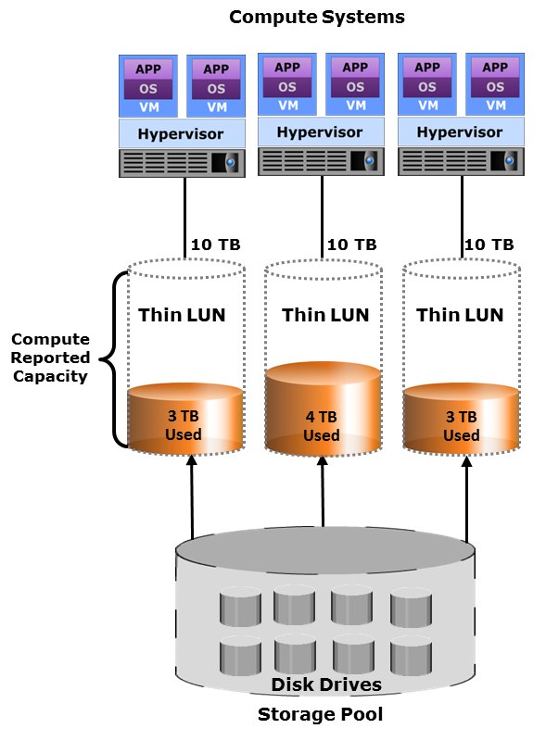
Virtual Storage Provisioning
Virtual Storage Provisioning
It enables to present a LUN to an application with more capacity than is physically allocated to it on the storage system.
Physical storage is allocated to the application on-demand
Provides more efficient utilization of storage and reduces storage cost
Simplified storage management
Two types of LUNs can be created:
Thin LUN
Thick LUN
Notes:
One of the biggest challenges for administrators is allocating the storage space required by various applications (or services) running in their IT infrastructure. With traditional storage provisioning, administrators typically allocate storage capacity to applications based on anticipated storage requirements. Administrators often over-provision storage to an application, either to avoid frequent provisioning of storage if the LUN capacity is exhausted, or to reduce disruption to application availability when adding new storage. Over allocation results in unused storage space, and lower capacity utilization. Also, results in acquisition of excess storage capacity, which leads to higher costs, increased power consumption, cooling, and floor space requirements.
Virtual storage provisioning enables to present a LUN to an application with more capacity than is physically allocated to it on the storage system. Physical storage is allocated to the application “on-demand” from a storage pool of physical capacity. This provides more efficient utilization of storage by reducing the amount of allocated-but-unused physical storage. The storage pool enables rapid elasticity of storage resources to adapt to the variations in workload by quickly and dynamically expanding (scaling outward) or reducing (scaling inward), and maintaining the required service level.
Virtual storage provisioning enables service providers to reduce storage costs by increasing capacity utilization and simplifying storage management. It also helps to reduce power and cooling, and floor space requirements. As a result, virtual storage provisioning has become a part of green computing.

Slide 31
Storage Pool Rebalancing
Provides the ability to rebalance allocated extents on physical disk drives over the pool when new drives are added
Restripes data across all disk drives in the shared storage pool
Helps in achieving higher overall pool performance
Enables spreading out the data equally on all the drives within the pool
Ensures that the used capacity of each drive is uniform across the pool
Notes:
When a storage pool is expanded, the sudden introduction of new empty drives combined with relatively full existing drives causes a data imbalance. It also may cause performance impact due to the fact that the new data would be added mostly to the newly added drives. Storage pool rebalancing is a technique that provides the ability to automatically rebalance allocated extents on physical disk drives over the entire pool when new disk drives are added to the pool. Rebalancing restripes data across all the disk drives (both existing and new disk drives) in the shared storage pool. This enables spreading out the data equally on all the physical disk drives within the shared pool, ensuring that the used capacity of each disk drive is uniform across the pool and helps in achieving the higher overall pool performance.

Slide 32
Storage Space Reclamation
Identifies unused space in thin LUNs and re-assigns it to the storage pool
Provides cost savings
Options to reclaim the unused space on a thin LUN
Zero extent reclamation
De-allocate storage extents that contain all zeroes in a thin LUN
De-allocated extents are added back to the pool
API-based reclamation
API communicate the location of all the identified unused space on the LUN to the storage system to reclaim all unused space to the pool
Notes:
Virtual storage provisioning provides the cloud administrator a way to substantially reduce over-allocating storage to applications and manage the capacity based on usage instead of allocated size. This allows the administrator to maintain a common, unallocated storage space that is readily available to other applications or services on an as-needed basis. But even with virtual storage provisioning, there can be unused storage in a thin LUN, if space from deleted blocks is not reclaimed. Consider a scenario where large file deletions are common and significant numbers of unused storage blocks are not reclaimed to the storage pool from the thin LUN. In such cases, reclaiming the unused space from thin LUNs would be beneficial to the overall physical storage space availability. Thin LUN storage space reclamation technique identifies the unused space in thin LUNs and re-assigns it to the storage pool. There are multiple options available to reclaim the unused space on a thin LUN, such as zero extent reclamation and API-based reclamation. Zero extent reclamation is a method commonly implemented at the storage system that provides the ability to free or de-allocate storage extents found to contain all zeroes in a thin LUN. These de-allocated extents are added back to the pool, making them available for other applications. Another approach is to use a thin LUN storage space reclamation API, which can efficiently communicate the location of all the identified unused space on the LUN (where the VM files reside) to the storage system. This enables the storage system to reclaim all unused physical storage to the pool, making it available for other thin LUNs.

Slide 33
Automated Storage Tiering
Automated Storage Tiering
A technique of establishing a hierarchy of different storage types for different categories of data that enables storing the right data automatically to the right tier, to meet the service level requirements.
Each tier has different levels of protection, performance, and cost
Data is moved between tiers based on defined tiering policies
Tiering policy is usually based on parameters such as file type, frequency of access, and so on
Data movement occurs between tiers
Within a storage array (Intra-array)
Between storage arrays (Inter-array)
Notes:
Automated storage tiering is a technique of establishing a hierarchy of different storage types for different categories of data that enables storing the right data automatically to the right tier, to meet the service level requirements. Many applications have predictable spikes in activity, with much lower activity at other times. Ideally, an automated storage tiering solution addresses these cyclical fluctuations as well as unpredictable spikes that can also occur. Automated storage tiering has the potential to replace tedious manual storage management and to significantly benefit cloud environments. Tiers are differentiated on the basis of protection, performance, and cost. For example, high performance solid-state drives (SSDs) can be configured as tier 0 storage to keep frequently accessed data (hot data), and low cost SATA drives as tier 1 storage to keep the less frequently accessed data (cold data). Keeping frequently used data in SSD improves application performance. Moving less-frequently accessed data to more economical, higher capacity SATA drives can free up storage capacity in high performance drives and reduce the overall cost of storage. For example, if the focus of a cloud service is providing low- or no-cost capabilities that do not need a large amount of performance, then high-capacity, energy-efficient HDDs are an option. On the other hand, if the service requires low response time while supporting a large number of active users, SSDs are a good fit. This clearly tells that different tiers of storage media are aligned and used to meet different service requirements. The data is moved between tiers based on the defined tiering policies. The tiering policy is usually based on parameters such as file type, frequency of access, and so on. For example, if a policy states, “Move the files that are not accessed for the last 30 days to the lower tier,” then all the files matching this condition are moved to the lower tier. Data movement between various tiers can happen within (intra-array) or between (inter-array) storage arrays.

Slide 34

Cache Tiering
Enables creation of a large capacity secondary cache using SSDs
Enables tiering between DRAM cache and SSDs (secondary cache)
Most reads are served directly from high performance tiered cache
Key benefits:
Enhances performance during peak workload
Non-disruptive and transparent to applications
DRAM Cache
Tier 0
SSD
Tier 1
Cache Tier
Storage System
Notes:
Tiering may also be implemented at the cache level. A large cache in a storage system improves performance by retaining large amounts of frequently accessed data, so that a high proportion of reads are served directly from the cache. However, configuring a large cache in the storage system can be costly. An alternative way to increase the size of the cache is by utilizing the SSDs on the storage system to create a large capacity secondary cache positioned between the storage processor’s DRAM primary cache and the storage system’s disk drives. This enables tiering between DRAM primary cache and SSDs (secondary cache). Cache tiering also enables the storage system to store large amounts of frequently accessed data on the cache tier. Most reads may now be served directly from cache tiering, which provides excellent performance benefits during peak workload.

Slide 35
Dynamic VM Load Balancing Across Storage Volumes
Enables intelligent placement of VMs during creation, based on the I/O load and available storage capacity on the volume
Improves the performance
Management server performs ongoing load balancing within a cluster of volumes
Cluster volume is a collection or pool of volumes that are aggregated as a single volume
Enables efficient and rapid placement of new VMs
User-configurable space utilization or I/O latency thresholds are defined to ensure space efficiency
Notes:
During the storage provisioning process for VMs, the volumes are often randomly selected, and virtual disks are created for VMs on these volumes. This may lead to over or underutilized volumes. Dynamic VM load balancing across storage volumes enables intelligent placement of VMs during creation, based on the I/O load and available storage capacity on the hypervisor’s native FS volume or the NAS FS volume. This technique is implemented in a centralized management server that manages the virtualized environment. A management server performs ongoing dynamic VM load balancing within a cluster of volumes. A cluster volume is a collection or pool of a hypervisor’s native FS or NAS FS volumes that are aggregated as a single volume to enable efficient and rapid placement of new virtual machines and load balancing on existing workloads. User-configurable space utilization or I/O latency thresholds are defined to ensure space efficiency, and I/O bottlenecks are avoided. These thresholds are typically defined during the configuration of the clustering volumes to avoid resource bottlenecks and to meet application service levels.

Slide 36
Lesson Summary
During this lesson the following topics were covered:
Virtual storage provisioning
Storage pool rebalancing
Storage space reclamation
Automated storage tiering
Cache tiering
Dynamic VM load balancing across storage volumes
Notes:
This lesson covered the key storage resource management techniques including virtual storage provisioning, storage pool rebalancing, thin LUN storage space reclamation, automated storage tiering, cache tiering, and dynamic VM load balancing across storage volumes.

Slide 37
Lesson: Resource Management Technique – 3
This lesson covers the following topics:
Balancing client workload across nodes
Network storm control
Quality of Service
Traffic shaping
Link aggregation, NIC teaming, and multipathing
Notes:
This lesson covers the key network resource management techniques including balancing client workload across nodes, network storm control, Quality of Service, traffic shaping, link aggregation, NIC teaming, and multipathing.

Slide 38
Introduction to Network Traffic Management
Network traffic flow is controlled and managed to optimize the performance and availability of cloud services
Key network traffic management techniques are:
Balancing client workload across nodes
Network storm control
Quality of Service (QoS)
Traffic shaping
Link aggregation
NIC teaming
Multipathing
Notes:
Network traffic flow in a cloud network infrastructure is controlled to optimize both performance and availability of cloud services. Administrators may use several traffic management techniques supported by different vendors of network resources. Some of these techniques enable distribution of traffic load across nodes or parallel network links to prevent overutilization or underutilization of these resources. Other techniques enable automatic failover of network traffic from a failed network component to another available component. Some techniques also ensure guaranteed service levels for a class of traffic contending with other classes for network bandwidth. The key network traffic management techniques, listed on the slide, are described in the subsequent slides.

Slide 39

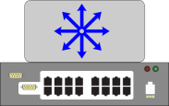
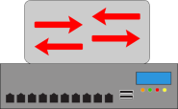

Balancing Client Workload across Nodes
Splits client workload across multiple nodes
Usually performed by a purpose-built device called load balancer
Load balancer is placed between node cluster and Internet
Load balancer decides where to forward each request
Ethernet Switch
Server 1 Private IP A.A.A.A
Load Balancer
Server 2 Private IP B.B.B.B
Internet
webapp.sample.com public IP Z.Z.Z.Z
Server 3 Private IP C.C.C.C
Ethernet Switch
Notes:
Client (consumer) connections are typically balanced across a group of nodes such as a cluster of application servers that process clients’ requests simultaneously. The client workload balancing service is usually provided by a purpose-built device called load balancer. The load balancer splits client traffic across multiple nodes. The working principle of a load balancer may vary based on vendor implementation. A common load balancing method is to place the load balancer between the node cluster and the Internet. This allows all client traffic to pass through the load balancer. Clients use the IP address of the load balancer to send requests. This IP address is called a public IP address because it is accessible for general use. The public IP address abstracts the real (private) IP addresses of all nodes in the cluster. The private IP addresses of the nodes are known only to the load balancer, which decides where to forward each request. This slide shows an example of load balancing. In this example, there are three application servers, each with a private IP address. A load balancer is placed in the network, before the application servers, and provides a publicly accessible IP address and a domain name webapp.sample.com. When a cloud consumer accesses the application located at webapp.sample.com, they are directed to the load balancer, and are then redirected to one of the application servers.

Slide 40
Network Storm Control
Storm Control
A networking technique that prevents regular network traffic on a LAN or VLAN from being disrupted by a network storm. A network storm occurs due to flooding of frames on a LAN or VLAN, creating excessive traffic and resulting in degraded network performance.
Switch monitors incoming frames to switch ports over specific time interval
Switch counts frames of specific type over the interval
Switch compares the count with pre-configured threshold
Switch port blocks traffic when threshold is reached and filters out subsequent frames until the interval ends
Notes:
A network storm occurs due to flooding of frames on a LAN or a VLAN, creating excessive traffic and resulting in degraded network performance. A storm could happen due to errors in the network configuration, or a denial-of-service (DoS) attack.
Network storm control is a technique to prevent regular network traffic on a LAN or VLAN from being disrupted by a network storm and thereby avoiding degraded network performance. If storm control is enabled on a supported LAN switch, it monitors all incoming frames to switch ports over specific time interval. The switch calculates the total number of frames of a specific type (unicast, multicast, or broadcast) that arrive at a switch port over the interval. The switch then compares the sum with a pre-configured storm control threshold. The switch port blocks the traffic when the threshold is reached and filters out subsequent frames until the interval ends.

Slide 41
Quality of Service (QoS)
Quality of Service
Capability of a network to prioritize business critical and latency-sensitive network traffic and to provide better service to such traffic over less critical traffic. QoS enables applications to obtain consistent service levels in terms of network bandwidth, latency variations, and delay.
Approach | Description
Integrated Services | Application signals the network to inform network components about required QoS Application can transmit data through network only after receiving confirmation from the network
Differentiated Services | Priority specification to network packets are inserted by applications or by switches or routers Network uses priority specification to classify traffic and then manage network bandwidth based on the traffic class
Notes:
Quality of service (QoS) refers to the capability of a network to prioritize business critical and latency-sensitive network traffic and to provide better service to such traffic over less critical traffic. QoS uses a collection of technologies that allows applications to obtain consistent service levels in terms of network bandwidth, latency variations, and delay. This is performed by raising the priority of critical classes of network traffic over other classes. For example, if an organization uses their network to route voice calls they would want to assign a higher priority to this data compared to web or email traffic. Milliseconds of delay have little if any effect on web or mail traffic while it can make live voice unintelligible.
The Internet Engineering Task Force (IETF) defines two approaches for QoS: integrated services and differentiated services. In integrated service, an application signals the network to inform the network components about required QoS. The signal carries a request about the network bandwidth and permissible delay for the application’s network traffic. If every network component along the data path can reserve the necessary bandwidth, the originating application can begin transmitting. The application can transmit data through the network only after receiving confirmation from the network.
For differentiated service, different network traffic get different QoS based on the priority specified by each packet. The network uses the priority specification to classify traffic and then manage network bandwidth based on the traffic class. The priority specification to the packets can be inserted by applications or by switches or routers. There are different ways to specify the priority. For example, three precedence bits in the type of service (ToS) field of the IP packet header are used as a priority specification. In Ethernet network, the class of service (CoS) field specifies the priority.

Slide 42
Traffic Shaping
Limits the traffic rate at a network interface such as a node port or a router port
If traffic rate exceeds the pre-configured limit, traffic shaping queues excess packets for later transmission
Ensures required service level for business-critical applications
Controls traffic rate per client/tenant to avoid network congestion
Traffic Rate
Traffic Rate
Rate Limit
Time
Time
Without Traffic Shaping
With Traffic Shaping
Notes:
Traffic shaping limits the traffic rate at a network interface such as a node port or a router port. This helps to limit the rate of low priority network traffic, which improves latency and increases available network bandwidth for higher priority traffic. In addition to ensuring the required service level are met for business-critical applications, it also helps to control the traffic rate per client or tenant, avoiding network congestion. Traffic shaping can be performed by a node or an interconnecting device.
Traffic shaping allows an administrator to set a limit on the traffic rate on a network interface. In the event of a traffic burst that exceeds the limit, traffic shaping retains excess packets in a queue and then schedules the excess packets for later transmission. In this way it ensures consistent traffic rate at a network interface and meets the required service level.

Slide 43
Link Aggregation, NIC Teaming, and Multipathing
Link aggregation
Combines links between two switches and between a switch and a node
Enables distribution of network traffic across links in the aggregation
NIC Teaming
Distributes network traffic across NICs
Provides network traffic failover in the event of a NIC/link failure
Multipathing
Provides load balancing and path failover
Improves I/O performance and data path utilization
Notes:
Link aggregation combines two or more parallel network links into a single logical link, called port-channel, yielding higher bandwidth than a single link could provide. Link aggregation enables distribution of network traffic across the links and traffic failover in the event of a link failure. If a link in the aggregation is lost, all network traffic on that link is redistributed across the remaining links. Link aggregation can be performed for links between two switches and between a switch and a node.
NIC teaming is a link aggregation technique that logically groups NICs (to create a NIC team) so that they appear as a logical NIC. It distributes network traffic across NICs and provides traffic failover in the event of a NIC/link failure.
Multipathing can perform load balancing by distributing I/O across all active paths. Standby paths become active if one or more active paths fail. If an active path fails, the multipathing process detects the failed path and then redirects I/Os of the failed path to another active path.
Link aggregation, NIC teaming, and multipathing techniques are detailed in the ‘Business Continuity’ module.

Slide 44
Lesson Summary
During this lesson the following topics were covered:
Balancing client workload across nodes
Network storm control
Quality of Service
Traffic shaping
Link aggregation, NIC teaming, and multipathing
Notes:
This lesson covered the key network resource management techniques: balancing client workload across nodes, network storm control, Quality of Service, traffic shaping, link aggregation, NIC teaming, and multipathing.

Slide 45
Concepts in Practice
EMC Unisphere
EMC Unified Infrastructure Manager (UIM)
EMC ViPR and ViPR SRM
EMC FAST VP
EMC XtremSF
EMC PowerPath/VE
Notes:
The Concepts in Practice section covers EMC products such as Unisphere, Unified Infrastructure Manager, ViPR, ViPR SRM, FAST VP, XtremSF, and PowerPath/VE.
Note:
For the latest information on EMC products, visit www.emc.com.

Slide 46
EMC Unisphere and EMC UIM
Unisphere |  | UIM
Provides unified management for file-based, block-based, and object-based storage Enables to monitor health, alerts, and performance of large numbers of VNX storage systems Enables to create storage pool and to configure tiering Enables administrators to drill down and troubleshoot the issues |  | Unified management solution for Vblock and VSPEX systems Enables configuring and provisioning resources for services Provides a dashboard showing infrastructure configurations and utilization Performs compliance check during resource configurations Rapidly performs root cause analysis
Notes:
EMC Unisphere is a unified storage management platform (element manager) that provides intuitive user interfaces for managing EMC VNX and VNXe storage arrays, and EMC RecoverPoint. Unisphere is web-enabled and supports remote management of storage arrays. Unisphere allows VNX administrators to monitor health, alerts, and performance of large numbers of VNX storage systems across a central location. It provides easy-to-use customizable dashboard that aggregates system information like capacity, CPU utilization, health, and alerts. Some of the key capabilities offered by Unisphere are as follows:
Provides unified management for file, block, and object storage
Provides single sign-on for all devices in a management domain
Supports automated storage tiering and ensures that data is stored in the right tier to meet performance and cost
Provides management of both physical and virtual components
(Cont'd)

Slide 47
EMC Unisphere and EMC UIM
Unisphere |  | UIM
Provides unified management for file-based, block-based, and object-based storage Enables to monitor health, alerts, and performance of large numbers of VNX storage systems Enables to create storage pool and to configure tiering Enables administrators to drill down and troubleshoot the issues |  | Unified management solution for Vblock and VSPEX systems Enables configuring and provisioning resources for services Provides a dashboard showing infrastructure configurations and utilization Performs compliance check during resource configurations Rapidly performs root cause analysis
Notes:
EMC Unified Infrastructure Manager (UIM) is the unified management solution for Vblocks and VSPEX systems and provides a single point of management. With UIM, cloud infrastructure services can be provisioned automatically and according to corporate best practices. UIM discovers service elements, tracks changes to the elements, and checks compliance with configuration best practices. UIM captures alerts and displays them for an administrator to view. Alerts are notifications to the administrators about adverse events and impending threats in the IT infrastructure such as component failure and configuration error. It also provides a topological map of the Vblock and VSPEX infrastructure. This allows the administrator to drill down through the map to view the physical and virtual elements affected by a fault. In addition, UIM exposes APIs that can be utilized by external tools for service automation and orchestration.

Slide 48
EMC ViPR and EMC FAST VP
ViPR/ViPR SRM |  | FAST VP
EMC ViPR A software-defined storage solution Separates the management functions from the storage Centralizes storage management centrally through software EMC ViPR SRM Enables management of physical infrastructure under ViPR control and helps associate relationships between physical and software-defined resources |  | Performs storage tiering at sub-LUN level Data movement between tiers are based on user-defined policies Optimizes performance and cost Increases storage efficiency Supported on both VMAX and VNX storage arrays
Notes:
EMC ViPR is a software-defined storage solution that abstracts storage with all its unique capabilities from physical arrays into a single pool of virtual storage. Storage administrators then create virtual storage arrays that they can manage at the virtualization layer according to automated policies. ViPR decouples the storage control path from the data path, which enables it to centralize all the provisioning and management tasks. ViPR automates provisioning by creating pre-defined, policy-driven, virtual storage arrays and delivering self-service access. It centralizes storage management and monitors utilization, performance, and health through a single management interface across physical and virtual storage. ViPR provides a hyper-scale, cloud architecture built with standard APIs, so any customer or service provider can extend it to support non-EMC storage and integrate with cloud stacks such as VMware and OpenStack. ViPR ships with a SolutionPack called ViPR Monitoring and Reporting which is designed to help storage administrators manage the software-defined resources in their ViPR environment. It offers capacity reporting for software-defined storage resources presented to ViPR tenants. And, it discovers capacity available from underlying physical arrays to support the provisioning of storage to ViPR.
EMC ViPR SRM enables organizations to visualize application to storage dependencies, analyze configurations and capacity growth, and optimize their environment. It provides detailed relationship and topology views from the application, to the virtual or physical compute system, down to the LUN to identify service dependencies. It also provides a view on performance trends across the data path and identifies compute systems competing for resources. ViPR SRM helps in analyzing configurations and capacity growth. It also helps to optimize the capacity to get the most out of the storage investment. It provides detailed capacity reporting that improves planning to enhance purchasing processes and reduce costs. It shows historical workloads and response times to determine that the administrator has selected the right storage tier.
EMC FAST VP performs storage tiering at a sub-LUN level in a virtual provisioned environment. FAST VP automatically moves more active data (data that is more frequently accessed) to the best performing storage tier, and it moves less active data to a lower performance and less expensive tier. Data movement between the tiers is based on user-defined policies, and is executed automatically and non-disruptively by FAST VP.

Slide 49
EMC XtremSF and PowerPath/VE
XtremSF |  | PowerPath/VE
A server-flash cache solution A PCIe flash card deployed in the compute system, which improves performance XtremSW Cache accelerates reads and protects data using write-through cache |  | Provides multipathing solution for VMware ESX/ESXi and Microsoft Hyper-V Provides advanced multipathing with path failover and load balancing across FC, iSCSI, or FCoE I/O paths
Notes:
EMC XtremSF is a PCIe flash card deployed in the compute system to dynamically improve application performance by reducing latency and accelerating throughput. It can also be used as a caching device in conjunction with server flash caching software EMC XtremSW Cache. The XtremSW Cache accelerates reads and protects data using write-through cache to the networked storage. It extends EMC FAST VP into the compute system, adding another tier of intelligence and performance to the I/O stack.
EMC PowerPath/VE provides multipathing solutions for physical compute systems running VMware ESX/ESXi and Microsoft Hyper-V hypervisors. It provides path failover and load-balancing across FC, iSCSI, or FCoE I/O paths. All I/Os to storage systems run through PowerPath/VE, which distributes I/O requests to a LUN across all the available paths. PowerPath/VE may be added to the hypervisor and used in place of the hypervisor’s native multipathing functionality to deliver advanced multipathing capabilities.

Slide 50
Module Summary
Key points covered in this module:
Control layer and its key functions
Element manager and unified manager
Software-defined approach for managing IT resources
Key resource management techniques
Notes:
This module covered control layer and its key functions. This module also covered element and unified manager, and software-defined approach for managing IT resources. It further covered the key resource management techniques to effectively utilize the IT resources for meeting the required service levels.

Slide 51
This slide intentionally left blank.

